Slide 1
3-Way Controlled Robotic Vehicle
Embedded Systems
Design
Ailton Lopes – A72852
Nuno Afonso – A65354

Slide 2
Agenda
1- Hardware Specification
1.1. Hardware Resources
1.2. System Hardware Schematics
1.3. Peripherals and Communication Protocols
2-Software Specification
2.1. Software Tools and Cots
2.3. Device Drivers
2.4. Threads Overview and Interface
2.5. Flowcharts
3- GUI Sketch
4- Gantt Diagram

Slide 3
Hardware
Specification

Slide 4
1.Hardware Resources
Robot System

Slide 5
Development Board Raspberry PI 2B
Specifications:
SoC: Broadcom BCM2836
CPU: 900 MHz quad-core ARM Cortex A7
GPU: Broadcom VideoCore IV @ 250 MHz
Memory: 1 GB (shared with GPU)
USB ports: 4
Storage: MicroSD
Network: 10/100Mbps Ethernet
Peripherals: 17 GPIO plus specific functions, and HAT ID bus
Power rating: 800 mA (4.0 W)
Power source: 5 V via MicroUSB or GPIO header

Slide 6
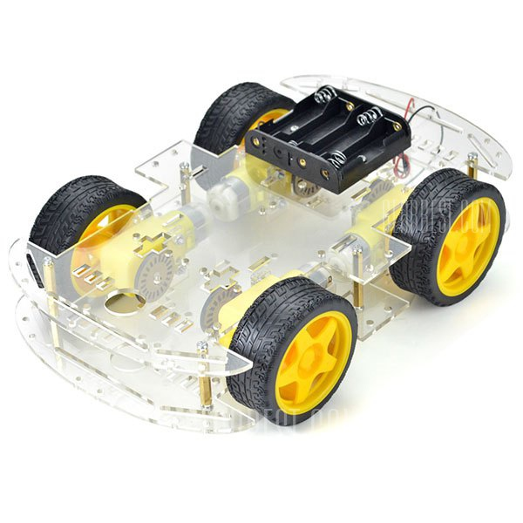
Robot Car Chassis Kit

Slide 7
Smart Robot Kit
Chassis Specification:
Chassis made from acrylic material
Product weight: 0.479 kg
Motors Specifications:
Motor Voltage: 3 - 12 V
Motor Current: 70 mA (typical) - 250 mA (max)
Speed: up to 170 RPM
Torque: up to 0.8 Kg
Gear Ration: 1:48
Wheel Diameter: 66 mm
Wheel Width: 27 mm

Slide 8
Smart Robot Kit
Motors Pin Description
Pin | Label | Description
1 | Motor - | Motor negative voltage
2 | Motor + | Motor positive voltage
Pin Assignment Motor 1 and 3:
Label | Connected to: | Interface
GND | Motor Driver – Output2 | PWM
VCC | Motor Driver – Output1 | PWM

Slide 9
Smart Robot Kit
Pin Assignment 2 and 4:
Label | Connected to: | Interface
GND | Motor Driver – Output4 | PWM
VCC | Motor Driver – Output2 | PWM
Motor Test Case
Input | Expected Output | Output
Voltage on the motors pins | Wheels rotates

Slide 10
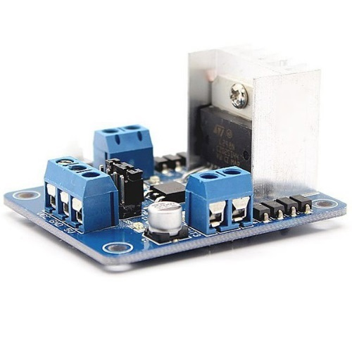
Motor Driver (L298)
Key Features:
Dual Full-Bridge Driver
Operating Suply voltage up to 46V
Low saturation Voltage
DC current up to 4V
High noise Immunity ( up to 1.5V)
Overtemperature Protection
Purpose:
Used in the robot system to control the Robot motors

Slide 11
Motor Driver (L298)
Pin Desription:
PIN | Label | Description/Function
1 | GND | Ground Voltage
2 | Out1 | MotorA&C + Voltage
3 | Out2 | MotorA&C - Voltage
4 | Out3 | MotorB&D + Voltage
5 | Out4 | MotorB&D - Voltage
6 | In1 | Pin to control motor A
7 | In2 | Pin to control motor A
8 | In3 | Pin to control motor B
9 | In4 | Pin to control motor B
10 | enA | Enable for Motor A&C
11 | enB | Enable for Motor C&D
12 | VCC | 5 Volt

Slide 12
Motor Driver (L298)
Pin Assignment:
Motor Driver L298N | Connected to: | Interface
VS | Battery + | -
In1 | RPI-Pin_11 - GPIO_0 | Input
In2 | RPI-Pin_13 - GPIO_2 | Input
In3 | RPI-Pin_15 - GPIO_3 | Input
In4 | RPI-Pin_16 - GPIO_4 | Input
enA | RPI-Pin_33- GPIO23 PWM1 | PWM -Input
enB | RPI-Pin_32- GPIO26 PWM0 | PWM -Input
GND | Battery – | -
Out1 | Motors A&C M1 | PWM - Output
Out2 | Motors A&C M2 | PWM - Output
Out3 | Motors B&D M1 | PWM - Output
Out4 | Motors B&D M2 | PWM - Output

Slide 13
Motor Driver (L298)
Test Case:
Input | Expected Output | Output
ENA = 0 | Motor A is disable
ENA = 1 IN1 = 0 IN2 = 0 | Motor A is stopped (brakes)
ENA = 1 IN1 = 0 IN2 = 1 | Motor A is on and turning backwards
ENA = 1 IN1 = 1 IN2 = 0 | Motor A is on and turning forwards
ENA = 1 IN1 = 1 IN2 = 1 | Motor A is stopped (brakes)

Slide 14
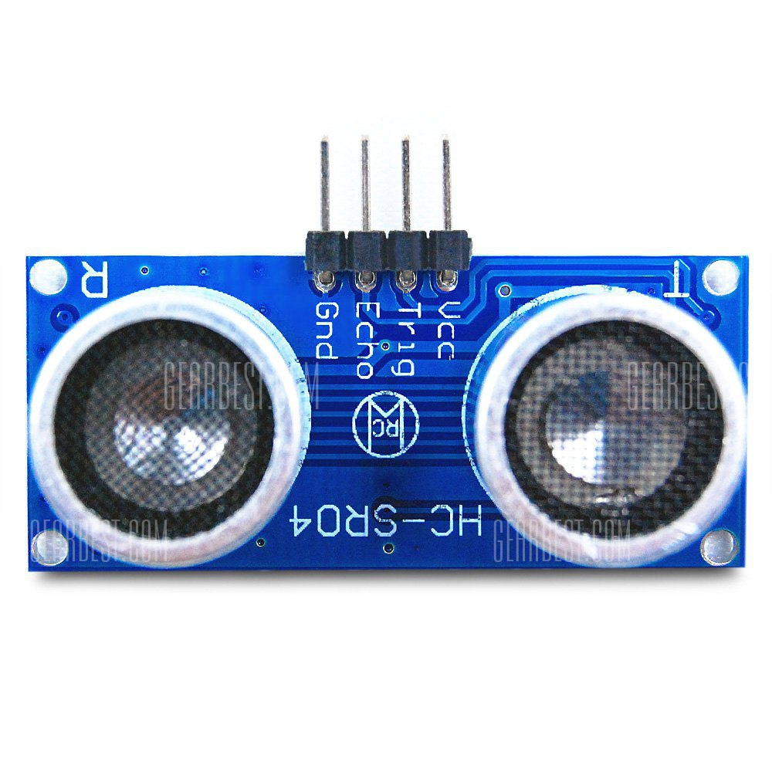
Ultrasonic Module HC - SR04
Specifications:
Power supply :5V
DC quiescent current: <2mA
Effectual angle: <15°
Ranging distance: 2cm – 500 cm
Resolution: 0.3 cm
Trigger Input Signal: 10uS TTL pulse
Dimension 45*20*15mm
Purpose:
Used to detect obstacle around the Robot System to avoid accidents.

Slide 15
Ultrasonic Module HC - SR04
Pin Description:
Pin | Label | Description
1 | VCC | Supply Voltage
2 | GND | Ground voltage
3 | Trigger | Trigger
4 | Echo | Echo
Pin Assignment
Label | Connected to: | Interface
VCC | Pin_02 - DC Power 5V | Supply Voltage
GND | Pin_09 - Ground | Ground voltage
Trigger | Pin_12 - GPIO1 PWM0 | PWM
Echo | Pin_22 - GPIO_6 | Output

Slide 16
Ultrasonic Module HC - SR04
Test Case
Input | Expected Output | Output
Obstacle in the Sensor Range | Receive Echo Signal

Slide 17
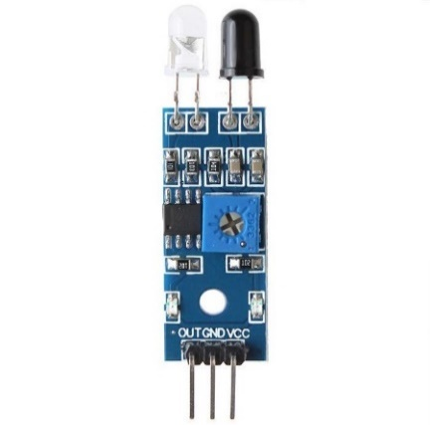
Infrared Barrier Sensor Module
Description:
Detection distance can be
adjusted through the potentiometer
knob, it is range from 2cm to 30cm.
Operating voltage: 3.3-5V
Purpose: Used in the Robot System to detect obstacle.
Pin Description
Pin | Label | Description
1 | VCC | Supply Voltage
2 | GND | Ground voltage
3 | Out | Output

Slide 18
Infrared Barrier Sensor Module
Pin Assignment
Label | Connected to: | Interface
VCC | Pin_2 - 5V DC Power | Vcc
GND | Pin_9 - Ground | GND
Out | Pin_18 - GPIO_5 | General Purpose Input
Test Case
Input | Expected Output | Output
Obstacle in the Sensor Range | Led Turn ON Output pin State gets High

Slide 19
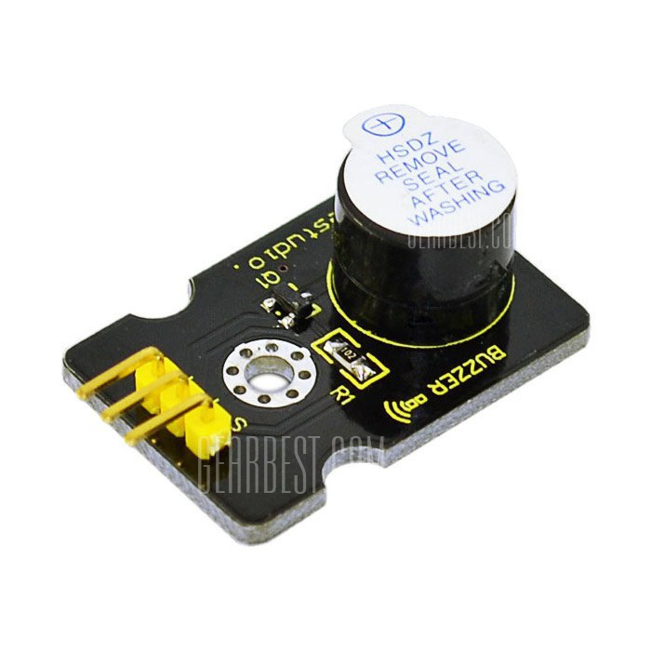
Buzzer
Main Features:
Power supply: 5V DC
Digital buzzer module, use high
/ low to drive, change the
Frequency, hear different sound
Weight: 0.005 kg
Purpose: Used to alert the user when na obstacle is detected in the direction of the movement of the Robot System.

Slide 20
Buzzer
Pin Description
Pin | Label | Description
1 | VCC | Suply Voltage
2 | GND | Ground Voltage
3 | Input | Input for the Buzzer
Pin Assignment
Label | Connected to: | Interface
VCC | Pin_2 - 5V DC Power | Vcc
GND | Pin_9 - Ground | GND
Input | Pin_19 - GPIO_6 | PWM

Slide 21
Buzzer
Test Case
Input | Expected Output | Output
PWM in the Input pin | The buzzer emit a sound

Slide 22
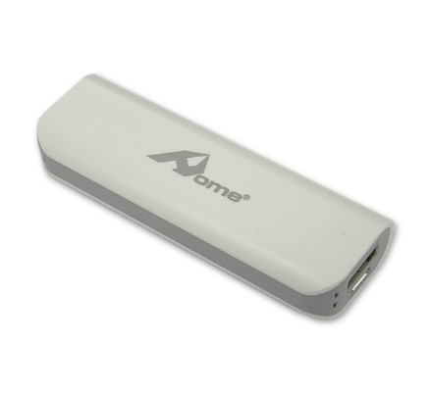
Power Bank
Description:
Input: MicroUSB
Output: USB
Voltage: 5V
Capacity: 2600mAh
Purpose: Power Suply for the Raspberry PI

Slide 23
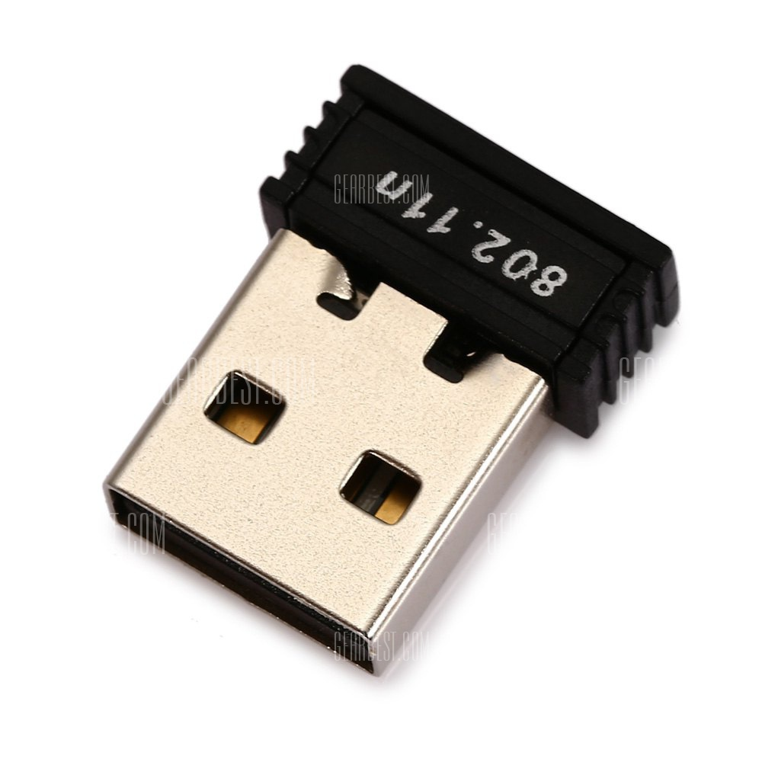
Wireless Wi-Fi Network Card
Description:
frequency : 2.4 GHz
compact form factor,
the USB adapter can reach
up to 150 Mbps over an
802.11n.
Purpose: Used for WI-FI communication

Slide 24
1.Hardware Resources
Controller System

Slide 25
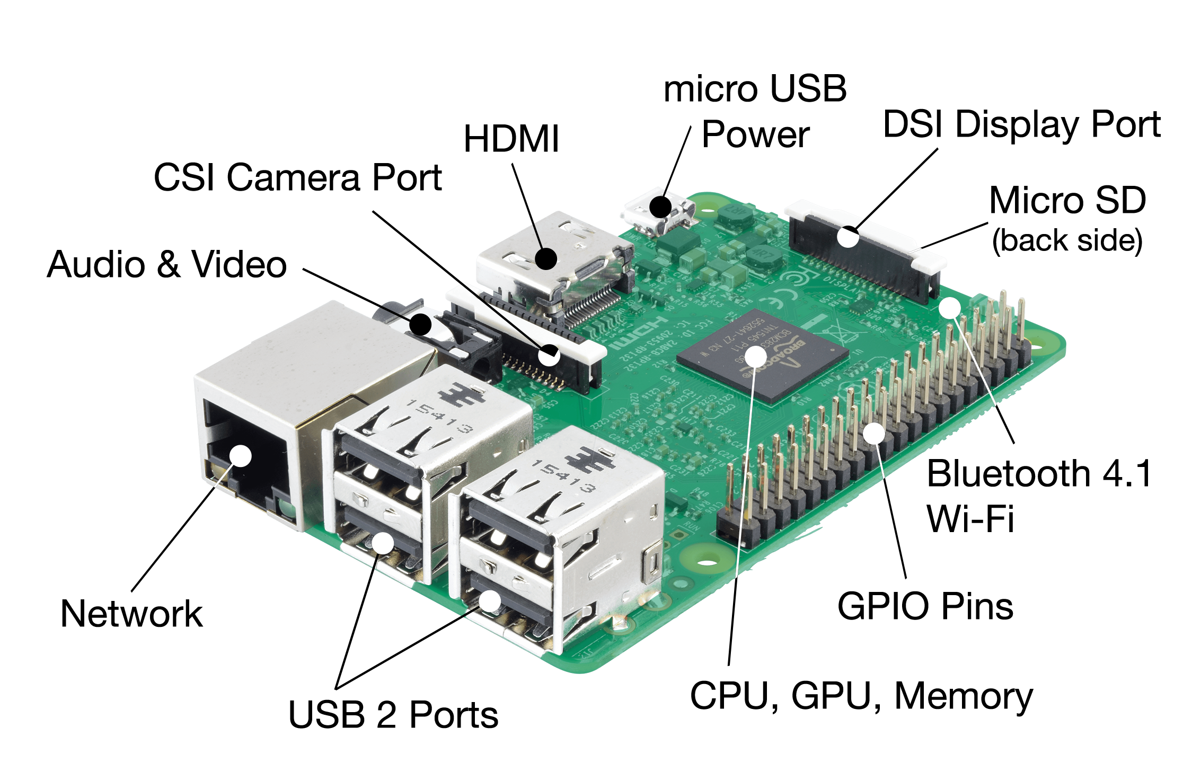
Hardware Resources
Development Board Raspberry PI 3

Slide 26
Development Board Raspberry PI 3
Specifications:
SoC: Broadcom BCM2837
CPU: 4× ARM Cortex-A53, 1.2GHz
GPU: Broadcom VideoCore IV
RAM: 1GB LPDDR2 (900 MHz)
Networking: 10/100 Ethernet, 2.4GHz 802.11n wireless
Bluetooth: Bluetooth 4.1 Classic
Storage: microSD
GPIO: 40-pin header, populated
Ports: HDMI, 3.5mm analogue audio-video jack, 4× USB 2.0, Ethernet…

Slide 27
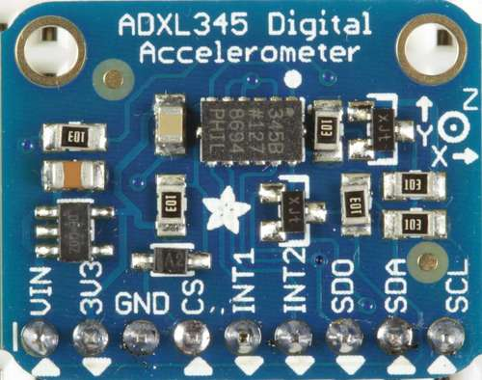
ADXL345 Accelerometer Sensor
Description:
low power, 3-axis accelerometer
with 13 bits of resolution.
Measurement at up to ±16 g.
Digital output accessible through
SPI or I2C digital interface.
Purpose: Measure the User hands or head movement (Input to the Controller System)

Slide 28
ADXL345 Accelerometer Sensor
Pin Description:
Pin | Label | Description
1 | VDD | Digital interface Supply Voltage
2 | GND | Ground voltage
3 | VS | Supply Voltage
4 | CS | Chip Select
5 | INT1 | Interrupt 1
6 | INT2 | Interrupt 2
7 | SDO/ALT ADDRESS | Serial Data Output/Alternate I2C Address
8 | SDA/SDI/SDIO | Serial data (I2C)
9 | SCL/SCLK | Serial Communication Clock

Slide 29
ADXL345 Accelerometer Sensor
Pin Assignment for I2C Communication:
label | Connected to: | Interface
CS | Pin_17 - 3.3V DC Power | I2C Select
SDA | Pin_03 - GPIO_02 (SDA1, I2C) | I2C Serial Data
SCL | Pin_05 - GPIO_03 (SCL1, I2C) | I2C Serial Clock
INT1 | Pin_29 - GPIO_05 | General Purpose Input (1)
VS | Pin_17 - 3.3V DC Power | Power Supply
VDD | Pin_17 - 3.3V DC Power | Digital Interface Power Supply
GND | GND | Ground Voltage
SDO | GND | Choose I2C Alternative address (0x53)
Test Case
Input | Expected Output | Output
Shake the sensor | LED On

Slide 30
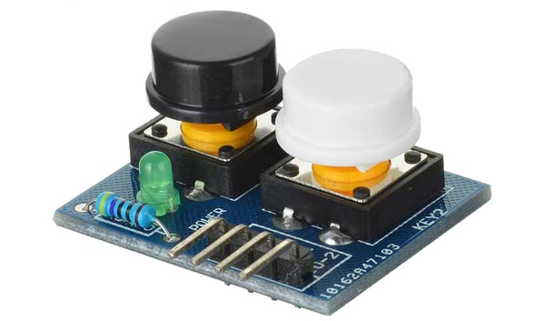
Touch Button Module
Description:
When module has detected
a key pressed, the
corresponding port will output
low level signal
Power supply voltage input range is 3 - 6V DC
Purpose: Used to Turn on and off the Robot System and to choose the Input for the controller System.

Slide 31
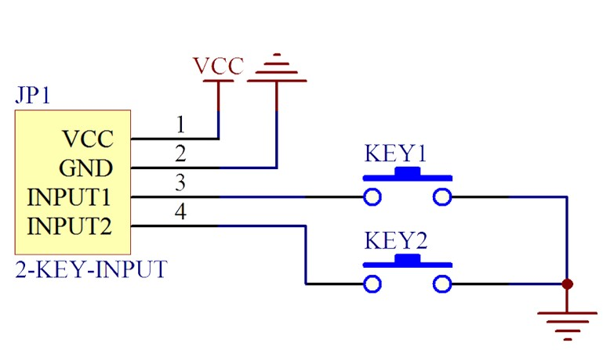
Touch Button Module
Schematics:
Pin Description:
Pin | Label | Description
1 | VCC | Supply Voltage
2 | GND | Ground voltage
3 | Input1 | Input for Button 1
4 | Input2 | Input for Button 2

Slide 32
Touch Button Module
Pin Assignment
Test Case
Label | Connected to: | Interface
VCC | Pin_02 - DC Power 5V | Supply Voltage
GND | Pin_09 - Ground | Ground voltage
Input1 | Input1 | I/O
Input2 | Input2 | I/O
Input | Expected Output | Output
Button 1 Pressed | Input1 Port output low level signal
Button 2 Pressed | Input2 Port output low level signal

Slide 33

Microphone
Specifications:
Input Impedance: 20 Ohms
Sensitivity (microphone):
42dBV/PA +/- 3dB
Frequency response (Microphone):
100Hz to 6,500Hz
Cord length: 1.8 m (5.90 ft)
Purpose: Used as input for the Voice commands in the Controller System.

Slide 34
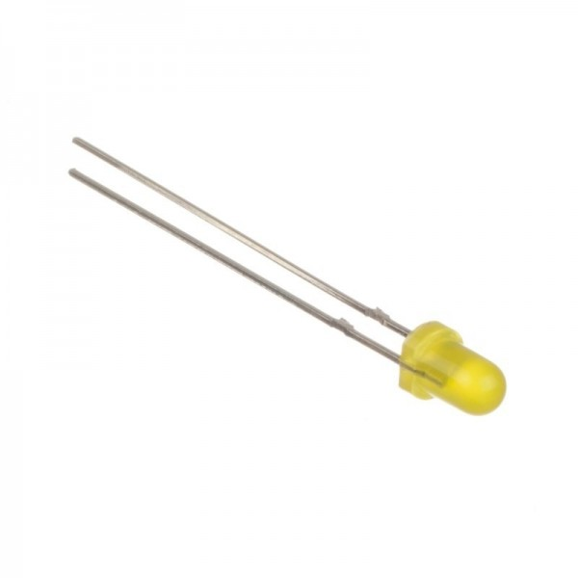
LEDs
Description: Diode type - LED LED diameter - 3mm Luminosity - 30mcd Viewing angle - 30° LED current - 20mA Operating voltage - 1.8...2.4V LED colour – yellow, Red and Green
Purpose:
Used to signal the user in the Controller System

Slide 35
LEDs
Pin Description:
PIN | Label | Description
1 | Anode (+) | positive charged electrode.
2 | Cathode (-) | Negative charged electrode.
Pin Assignment LED 1:
Label | Connected to: | Interface
Cathode | GND | Ground Voltage
Anode | Pin_32- GPIO_12 | Output
Pin Assignment LED 2:
Label | Connected to: | Interface
Cathode | GND | Ground Voltage
Anode | Pin_36 - GPIO_16 | Output

Slide 36
LEDs
Pin Assignment LED 3:
Label | Connected to: | Interface
Cathode | GND | Ground Voltage
Anode | Pin_32- GPIO_12 | Output
Pin Assignment LED 4:
Label | Connected to: | Interface
Cathode | GND | Ground Voltage
Anode | Pin_36 - GPIO_16 | Output
Test Case
Input | Expected Output | Output
High voltage on the Anode | Led emit light

Slide 37
Power Bank
Description:
Input: MicroUSB
Output: USB
Voltage: 5V
Capacity: 2600mAh
Purpose: Power Suply the Raspberry PI

Slide 38
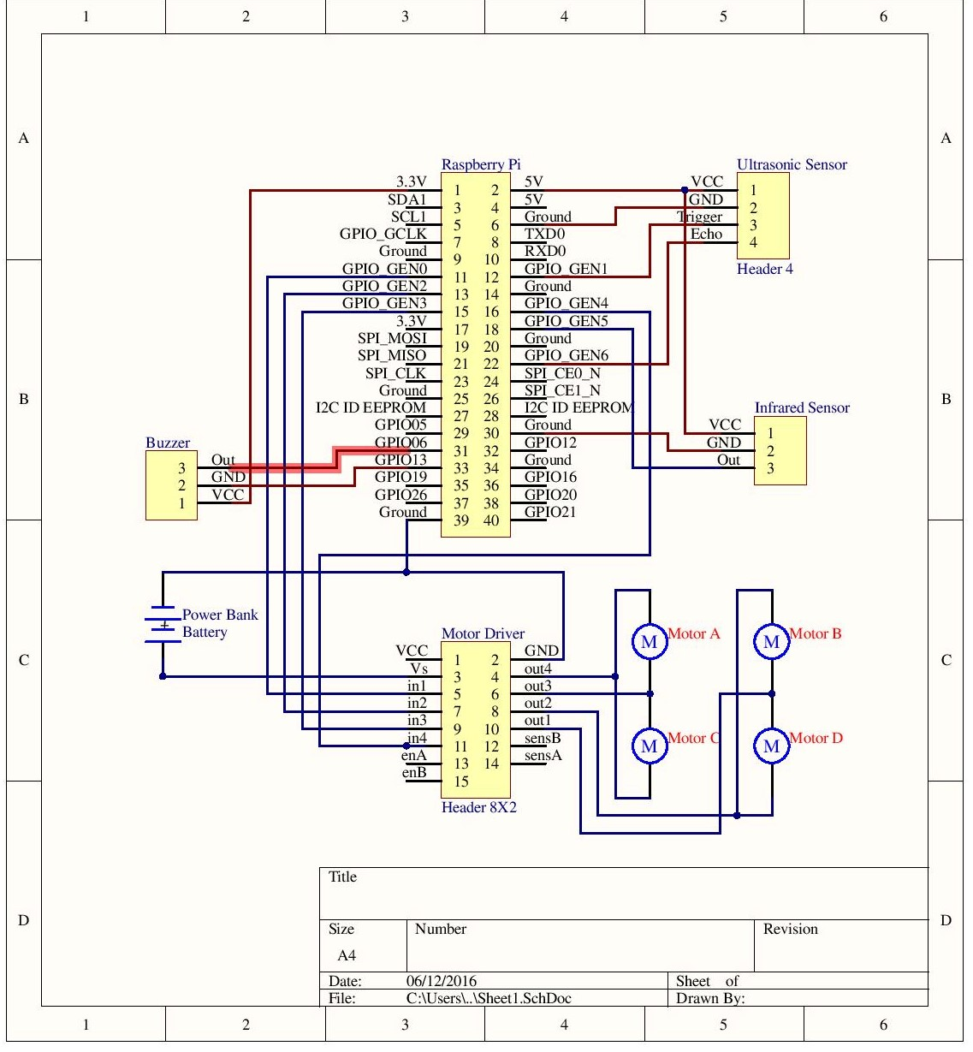
Hardware Schematics Robot System

Slide 39
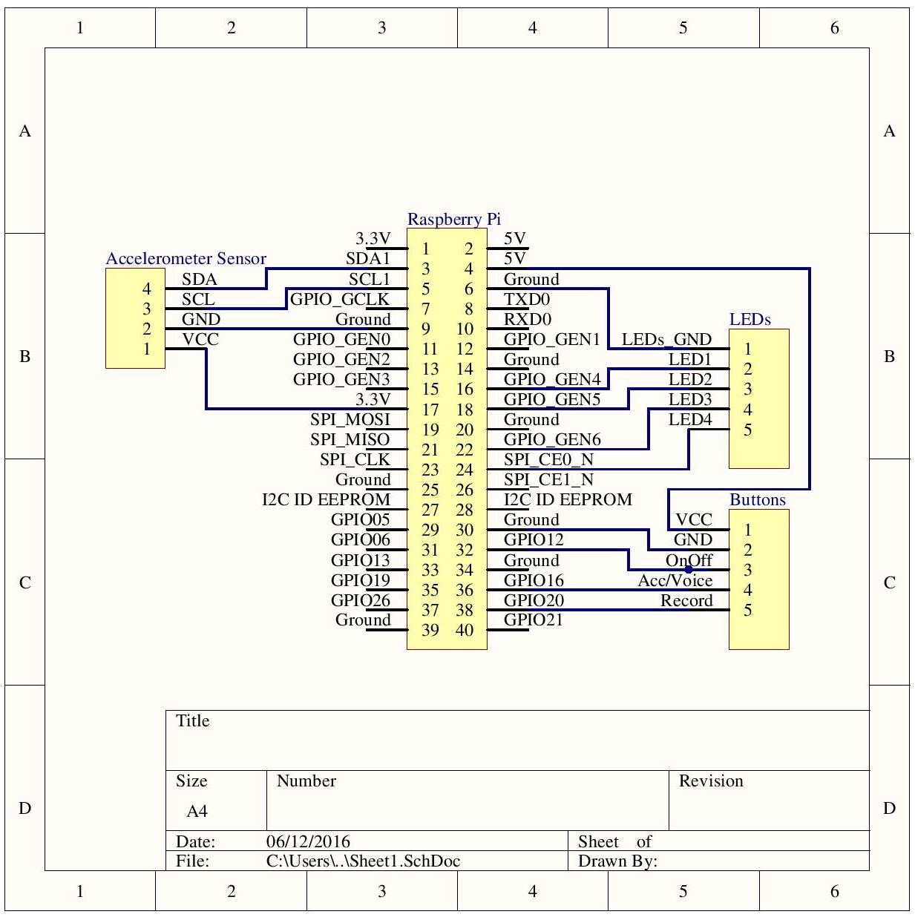
Hardware Schematics Controller System

Slide 40
3.Peripherals and Communication Protocol

Slide 41
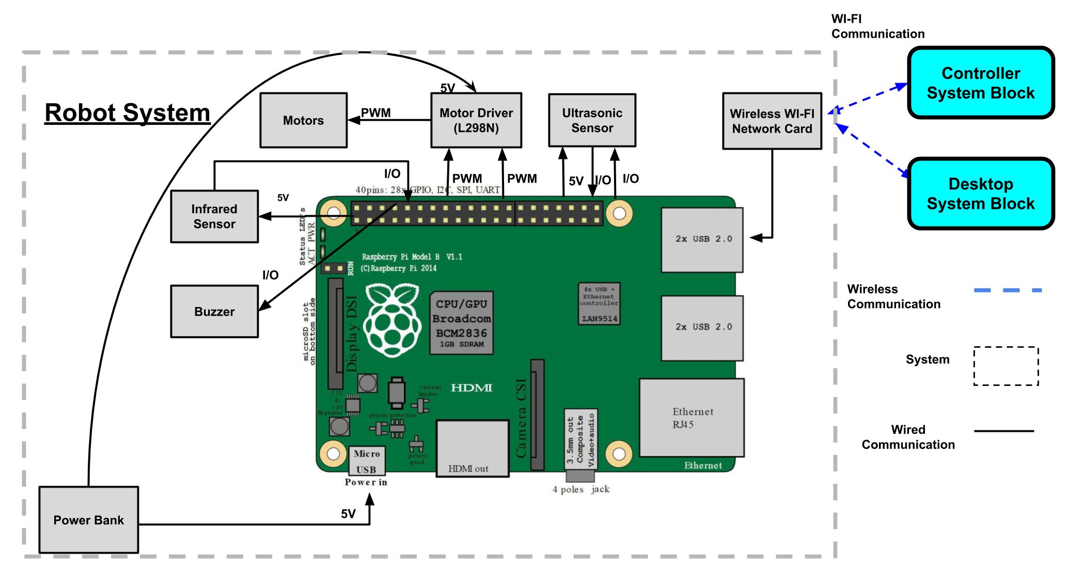
Robot System

Slide 42
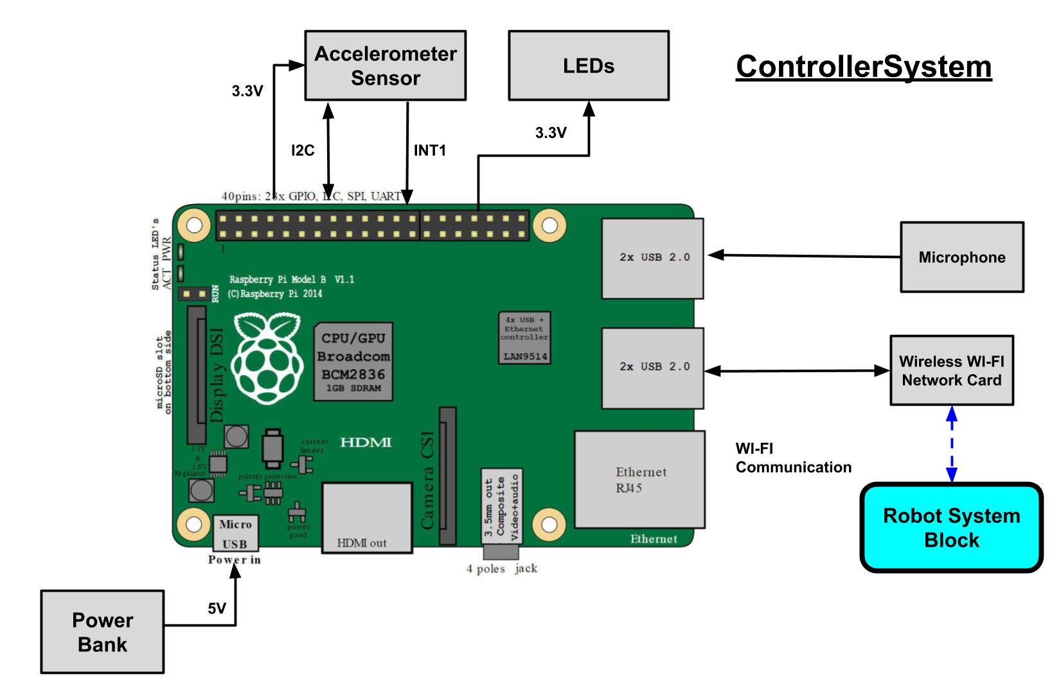
Controller System

Slide 43
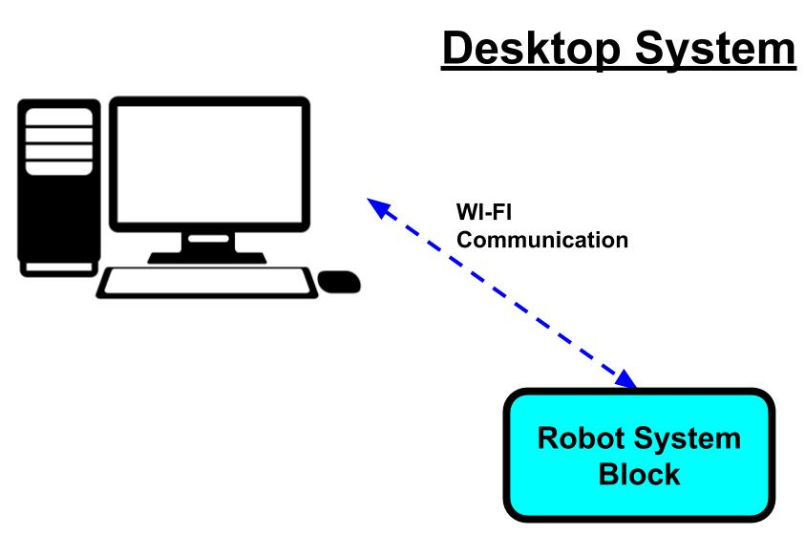
Desktop System

Slide 44
Software
Specification

Slide 45
1. Tools & Cots

Slide 46
Software Tools
Qt Creator 4.0.2 Based on Qt 5.7.0
To implement a graphical user interface in the Desktop Application
Buildroot
To automate the process of building a complete and bootable Linux environment for Robot System and Controller System

Slide 47
Software Cots:
Google speech APIs
WiringPi
Advanced Linux Sound Architecture (ALSA)
The Advanced Linux Sound Architecture (ALSA) provides audio and MIDI functionality to the Linux operating system. ALSA has the following significant features:
Fully modularized sound drivers.
SMP and thread-safe design.
User space library (alsa-lib) to simplify application programming and provide higher level functionality.
Support for the older Open Sound System (OSS) API, providing binary compatibility for most OSS programs.

Slide 48
3. Data Format

Slide 49
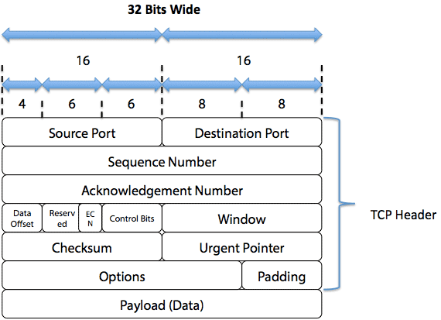
Data Formats:

Slide 50
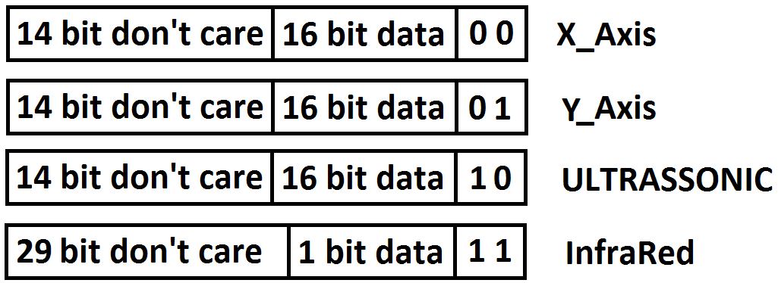
Data Formats
Messages to Desktop Application

Slide 51
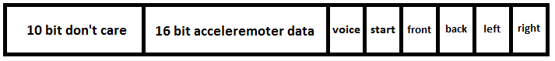
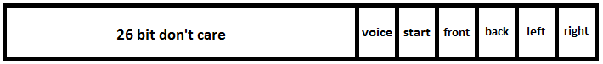
Data Formats
Messages to Robot
Accelerometer Data
Voice or Start/Stop Data

Slide 52
Static Architecture

Slide 53
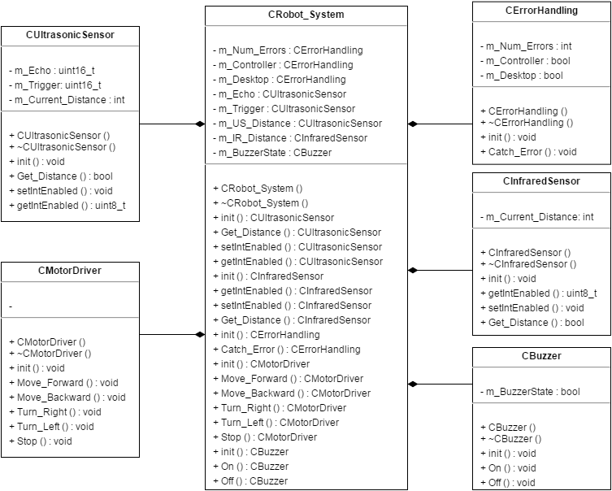
Robot System

Slide 54
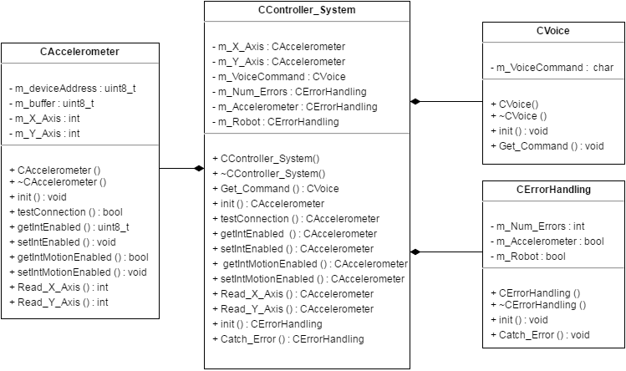
Controller System

Slide 55
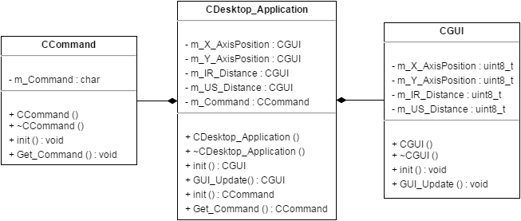
Desktop Application

Slide 56
4. Headers

Slide 57
Headers Robot System
class CUltrasonicSensor{
public:
CUltrasonicSensor (void);
~ CUltrasonicSensor (void);
void init (void);
uint8_t getIntEnabled (void);
void setIntEnabled (uint8_t enabled);
bool Get_Distance (void);
uint16_t m_Echo, m_Trigger;
int m_Current_Distance;
};

Slide 58
Headers Robot System
class CInfraredSensor{
public:
CInfraredSensor (void);
~ CInfraredSensor (void);
void init (void);
uint8_t getIntEnabled (void);
void setIntEnabled (uint8_t enabled);
bool Get_Distance (void);
int m_Current_Distance;
};

Slide 59
Headers Robot System
class CBuzzer{
private:
static void Send_Alarm (void);
bool m_BuzzerState;
public:
CBuzzer (void);
~ CBuzzer (void);
void init (void);
void On (void);
void Off (void);
};

Slide 60
Headers Robot System
class CMotorDriver{
static void Motor_Controller (void);
public:
CMotorDriver (void);
~ CMotorDriver (void);
void init (void);
void Move_Forward (void);
void Move_Backward (void);
void Turn_Right (void);
void Turn_Left (void);
void Stop (void);
};

Slide 61
Headers Robot System
class CErrorHandling{
int m_Num_Errors;
bool m_Controller;
bool m_Desktop;
static void Error_Handling(void);
public:
CErrorHandling (void);
~ CErrorHandling (void);
void init (void);
void Catch_Error(void);
};

Slide 62
Headers Robot System
Robot System ISRs:
void IRSensor_ISR (void);
void UltrasonicSensor_ISR (void)

Slide 63
Headers Controller System
class CAccelerometer {
private:
static void Accelerometer_Handler (void);
uint8_t m_deviceAddress, m_buffer[14];
public:
CAccelerometer (void);
~ CAccelerometer (void);
CAccelerometer (uint8_t address);
void init (void);
bool testConnection (void);
uint8_t getIntEnabled (void);
void setIntEnabled (uint8_t enabled);
bool getIntMotionEnabled (void);
void setIntMotionEnabled (bool enabled);
int Read_X_Axis (void);
int Read_Y_Axis (void); };

Slide 64
Headers Controller System
class CVoice {
private:
char m_VoiceCommand;
static void Voice_Recognition (void);
public:
CVoice (void);
~ CVoice (void);
void init (void);
void Get_Command (void);
};

Slide 65
Headers Controller System
class CErrorHandling{
int m_Num_Errors;
bool m_Accelerometer;
bool m_Robot;
static void Error_Handling(void);
public:
CErrorHandling (void);
~ CErrorHandling (void);
void init (void);
void Catch_Error(void);
};

Slide 66
Headers Controller System
Controller System ISRs:
void ISR_INT_Accelerometer(void);
void ISR_OnOff_Button(void)
void ISR_Mic_Record(void);
Void ISR_Timer_Tick(void);
Controller System Global Variables:
bool Input_Mode;
bool OnOff

Slide 67
Headers Desktop Application
class CGUI {
private:
uint8_t m_X_AxisPosition;
uint8_t m_Y_AxisPosition;
uint8_t m_IR_Distance;
uint8_t m_US_Distance;
static void Update_GUI(void);
public:
CGUI (void);
~ CGUI (void);
void init (void);
};

Slide 68
Headers Desktop Application
class CCommand {
private:
char m_Command;
static void Command_Handler(void);
public:
CCommand (void);
~ CCommand (void);
void init (void);
void Get_Command (void);
};

Slide 69
4. Threads

Slide 70
Threads Overview Robot System
Send_Wifi_Thread
Receive_Controller_Wifi_Thread
Receive_Desktop_Wifi_Thread
Command_Handler_Thread
Motor_Controller_Thread
Send_Alarm_Thread
Error_Handling_Thread

Slide 71
Threads Communication and Syncronization
Queue
Send_Alert_Queue – This message queue is used to send data from the ISRs Thread to the Send_Alarm thread
Receive_Queue – This message queue is used to send data from the Receive_Wifi Thread to the Command_Handler Thread
Send_Queue – This message queue is used to send data from the Command_Handler Thread to the Send_wifi Thread.
MotorPWM_Queue – This message queue is used to send the PWM for the Motors from the Command_Handler Thread to the Motor_Controller Thread.

Slide 72
Threads Communication and Syncronization
Error_Queue – used to send na error message to the Error_Handling Thread
ISRs:
IRSensor_ISR – Interrupt service routine to the Infrared Sensor.
UltrasonicSensor_ISR - Interrupt service routine to the Ultrasonic Sensor.

Slide 73
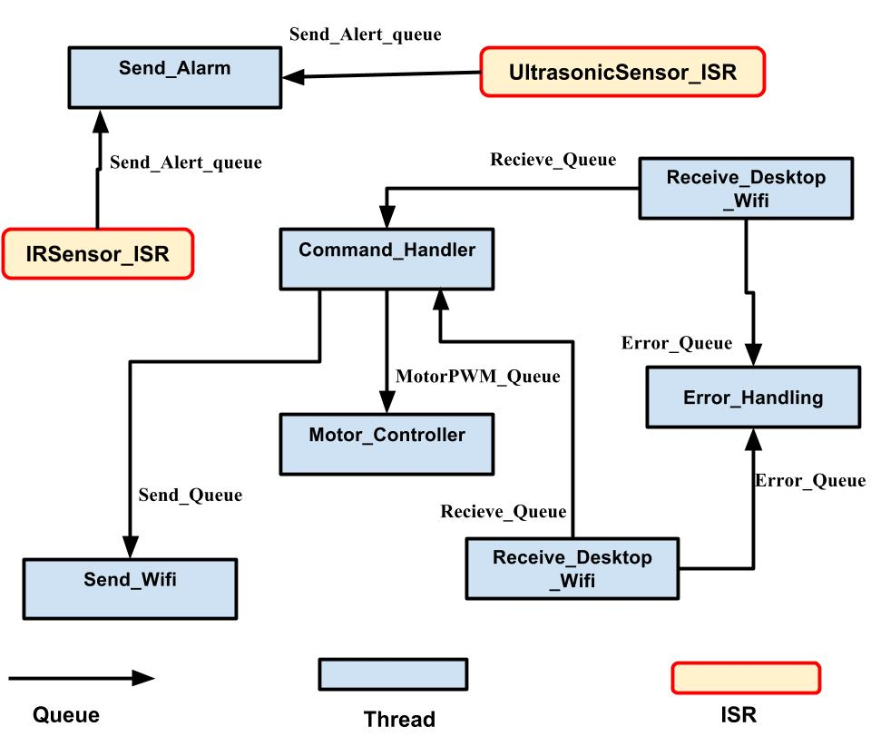
Robot System Threads Communication and Syncronization Overview

Slide 74
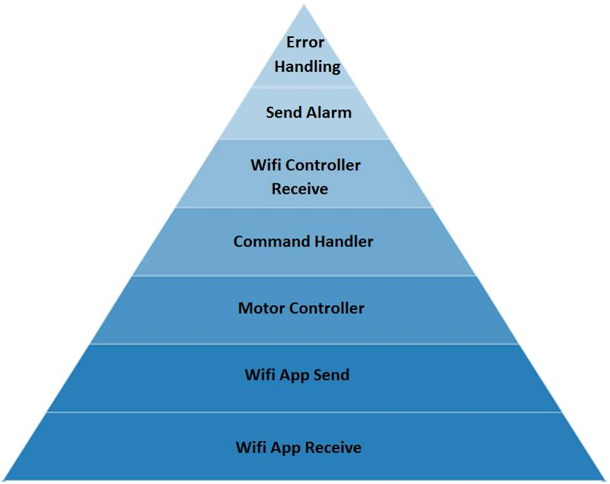
Robot System
Thread Priority

Slide 75
Threads Overview Controller System
Buttons_Handler_Thread
Send_Wifi_Thread
Voice_Recognition_Thread
Accelerometer_Handler
Error_Handling_Thread

Slide 76
Threads Communication and Syncronization
Semaphore:
Accelerometer_Sem - This Semaphore is used to send a signal to the Accelerometer_Handler thread when there is a new data from the Accelerometer.
ButtonModule_Sem - This Semaphore is used to send a signal to the Button_Handler thread when the On/Off button is Pressed or the Button to choose the controller input.
ButtonVoice_Sem - This Semaphore is used to send a signal to the Voice_Recognition thread when to record a new voice command.

Slide 77
Threads Communication and Syncronization
Queue
Send_Accelerometer_Queue – This message queue is used to send data from the Accelerometer_Handler thread to the Send_Wifi thread
Send_Voice_Queue – This message queue is used to send data from the Voice_Recognition thread to the Send_Wifi thread.
Error_Queue – used to send na error message to the Error_Handling Thread

Slide 78
Threads Communication and Syncronization
Mutex:
Input_Mode_mutex – used to protect the access to the variable that has the command Input mode (accelerometer or voice command).
OnOff_mutex – this mutex is used to protect the access to the OnOff global variable.
ISRs:
ISR_Button_OnOff: Interrupt service routine to the Touch Button Module.
ISR_Mic_Record: Interrupt service routine to the to start/stop Recording Button.
ISR_INT_Accelerometer: Accelerometer Interrupt service routine.

Slide 79
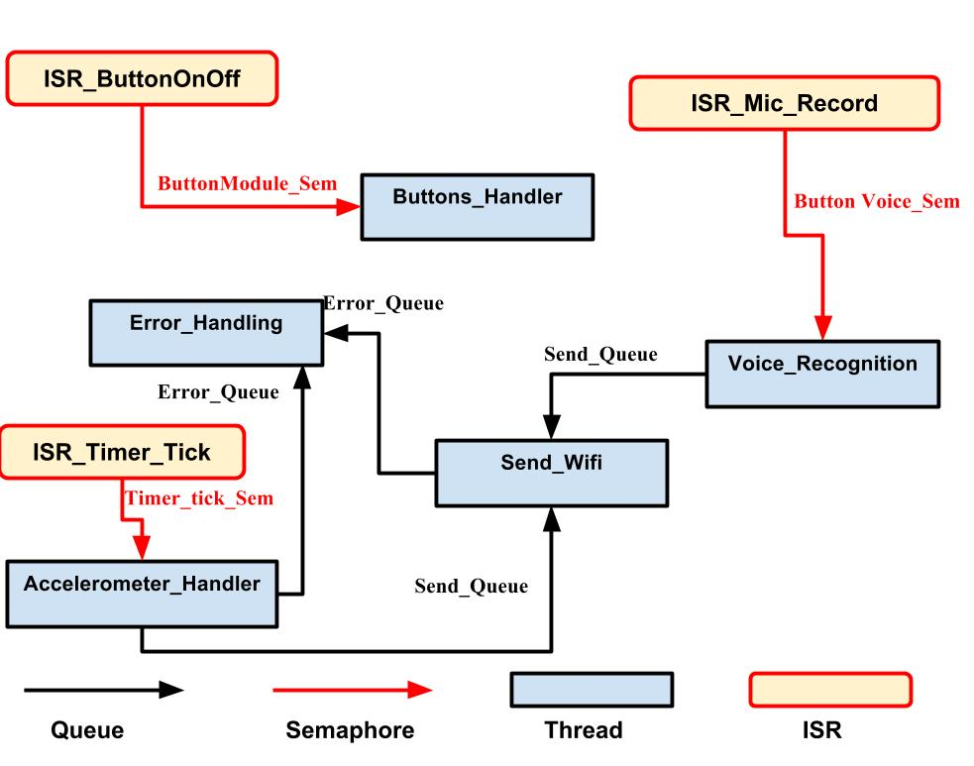
Controller System Threads Communication and Syncronization Overview

Slide 80
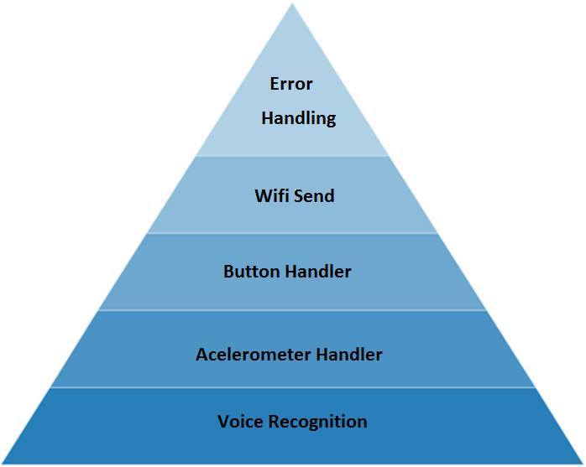
Controller System Thread Priority

Slide 81
Threads Overview Desktop Application
SendWifi_Thread
Receive_Wifi_Thread
Update_GUI_Thread
Command Handler_Thread

Slide 82
Threads Communication and Syncronization
Queue:
Update_GUI_Queue - is used to send the command received from the robot System from the Received_Wifi thread to the Update_GUI Thread.
New_Commmand_Queue – Is used to send the data from the Command_Handler thread to the Send_Wifi thread.

Slide 83
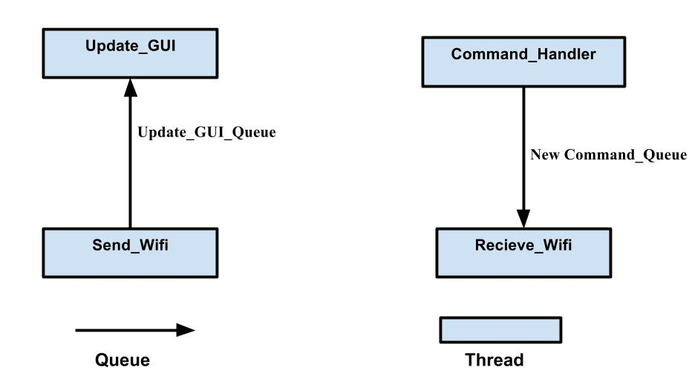
Desktop Application Threads Communication and Syncronization Overview

Slide 84
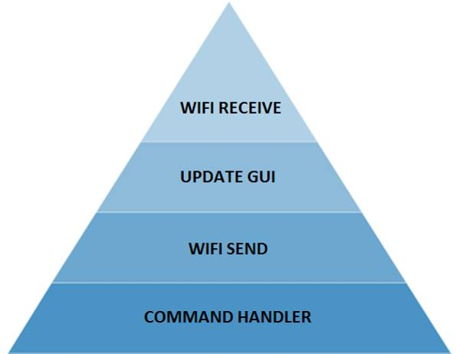
Desktop Application Thread Priority

Slide 85
5. Flowcharts

Slide 86
5.1. Robot System Flowcharts

Slide 87
Initialization

Slide 88
Receive_Controller_Wifi Thread Function
Write on a queue to the Error_Handling

Slide 89
Receive_Controller_Wifi Thread Function
Test Case
Input | Expected Output | Output
New Data Available | Process and send the data to the Command_handler Thread

Slide 90
Receive_Desktop_Wifi Thread Function
Write on a queue to the Error_Handling

Slide 91
Receive_Desktop_Wifi Thread Function
Test Case
Input | Expected Output | Output
New Data Available | Process and send the data to the Command_handler Thread

Slide 92
Send Wi-fi Thread Function
Write on a queue to the Error_Handling

Slide 93
Send_wifi Thread Function
Test Case
Input | Expected Output | Output
“Hello World” on send_queue | Send “Hello World” to the Desktop Application

Slide 94
Command Handler Thread Function

Slide 95
Command Handler Thread Function
Test Case
Input | Expected Output | Output
“START” on the queue | Start the motor
“STOP” on the queue | Stop the motor
“VOICE” on the queue | Set Voice command as input mode

Slide 96
Motor_Controller_Thread Function

Slide 97
Motor_Controller_Thread Function
Test Case
Input | Expected Output | Output
“Forward” on the queue | ENA = 1 , ENB = 1 IN1 = 1, IN2 = 0 IN3 = 1, IN4 = 0
“Backward” on the queue | ENA = 1 , ENB = 1 IN1 = 0, IN2 = 1 IN3 = 0, IN4 = 1
“Stop” on the queue | ENA = 0 and ENB = 0

Slide 98
Send_Alarm_Thread Function

Slide 99
Send_Alarm_Thread Function
Test Case
Input | Expected Output | Output
“Ultrassonic” on the queue | Stop the Robot and start the buzzer
“IR” on the queue | Stop the Robot and start the buzzer

Slide 100
Error_Handling Thread Function
Read the queue
Yes
Yes
No
No
Send a signal to Shutdown Thread
Wait for a new message on the queue

Slide 101
Error_Handling Thread Function
Input | Expected Output | Output
“Controller” on the queue | Delete Receive controller thread
“Desktop” on the queue | Delete Receive and send Desktop Thread
“Controller” on the queue after receiving previously na “Desktop” or vice-versa | Shutdown The Robot System

Slide 102
Shutdown Thread Function

Slide 103
Robot System Flowcharts
ISRs:
IRSensor_ISR UltrasonicSensor_ISR
Write on a queue to Send Alarm Thread

Slide 104
5.1. Controller System Flowcharts

Slide 105
Initialization Function

Slide 106
Send Wi-fi Thread Function
Write on a queue to the Error_Handling

Slide 107
Send_wifi Thread Function
Test Case
Input | Expected Output | Output
“Hello World” on send_queue | Send “Hello World” to the Robot System

Slide 108
Accelerometer_Handler Thread Function

Slide 109
Accelerometer_Handler Thread Function
Test Case
Input | Expected Output | Output
Semaphore signal | Write Accelerometers axis on the send_queue

Slide 110
Button_Handler Thread Function

Slide 111
Button_Handler Thread Function
Test Case
Input | Expected Output | Output
OnOff button Pressed | State = Stop Send stop to the Robot System
Acc/voice button pressed | Chage the value of the Input_Mode variable

Slide 112
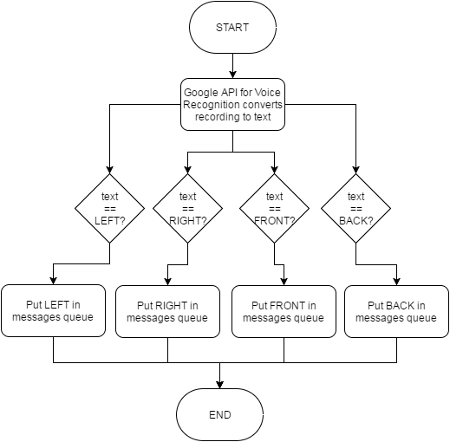
Voice_Recognition_Thread Function
Voice_To_Text

Slide 113
Voice_Recognition Thread Function
Test Case
Input | Expected Output | Output
“Stop” | Send “Stop” on the message queue

Slide 114
Error_Handling Thread Function
Read on the queue
Send a signal to Shutdown Thread
Wait for another message on the queue

Slide 115
Error_Handling Thread Function
Test Case
Input | Expected Output | Output
“Send_Robot” on the queue | Shutdown the controller system
“Acc” on the queue | Change input mode to Voice

Slide 116
Shutdown Thread Function

Slide 117
ISRs:
ISR_ButtonOnOff ISR_Timer_Tick ISR_Mic_Record

Slide 118
5.1. Desktop Application Flowcharts

Slide 119
Initialization Function

Slide 120
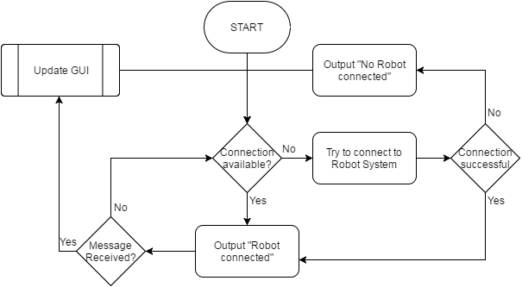
Receive Wi-Fi Thread Function

Slide 121
Receive_Desktop_Wifi Thread Function
Test Case
Input | Expected Output | Output
“Hello World” received via wifi | Send “Hello Wold” in the message queue to the GUI_Update thread

Slide 122
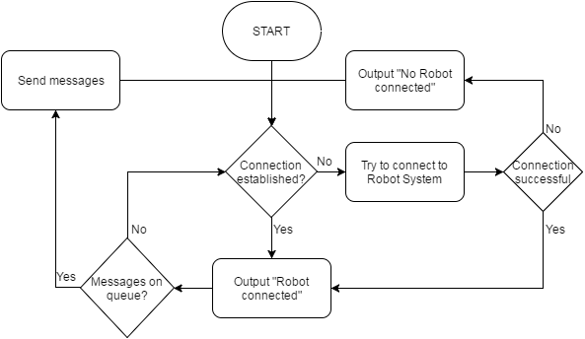
Send Wi-Fi Thread Function

Slide 123
Send_wifi Thread Function
Test Case
Input | Expected Output | Output
“Hello World” on send_queue | Send “Hello World” to the Robot System

Slide 124
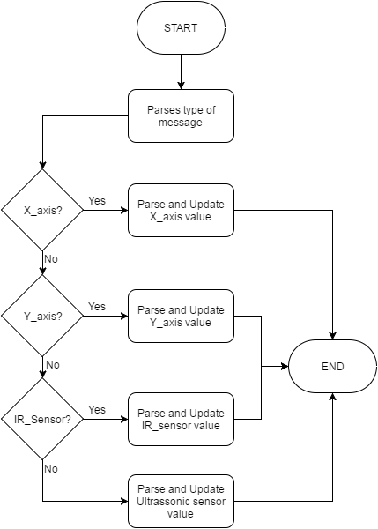
Update GUI Thread Function

Slide 125
Update GUI Thread Function
Test Case
Input | Expected Output | Output
“1000b” | Update the accelerometer X Axis to 2
“1001b” | Update the accelerometer Y Axis to 2
“1010b” | Update the Ultrassonic Distance to 2
“1010b” | Update the IR Distance to 0

Slide 126
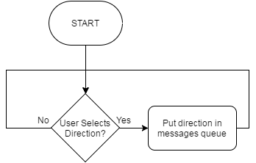
Command Handler Thread Function

Slide 127
Update GUI Thread Function
Test Case
Input | Expected Output | Output
“STOP” | Write “STOP” on the Message queue

Slide 128
Shutdown Thread Function

Slide 129
GUI Sketch

Slide 130
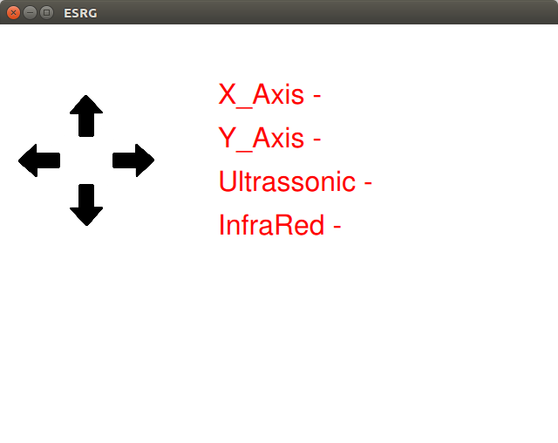
GUI Sketch

Slide 131
Task Division

Slide 132
Task Division
Task | Developer(s) | Knowledge | To Learn | Time
Sensors interface and Data acquisition | Ailton Lopes | How to interface the Proximity sensor in Arduino 30 - 40% | Learn how the Accelerometer sensor works Interface the sensors using the Raspberry PI 60% - 70% | 16 days
Buttons Data acquisition - | Nuno Afonso | 100% | - | 2 days
Data treatment – | Nuno Afonso | 80% | The best algorithm to detect the position hand based on the data measured by the sensors 20% | 8 days

Slide 133
Task Division
Motors Integration | Nuno Afonso | 60% | Studying the ways of implement PWM on the Raspberry PI 40% | 8 days
Communication system implementation | Ailton Lopes Nuno Afonso | 0% | Since it’s the first time we are implementing this type of communication we have everything to learn about it 100% | 20 days
Graphical interface implementation | Ailton Lopes Nuno Afonso | 100 % | - | 30 days
Assembling- | Ailton Lopes Nuno Afonso | 100% | - | 20 days

Slide 134
Gant Diagram

Slide 135
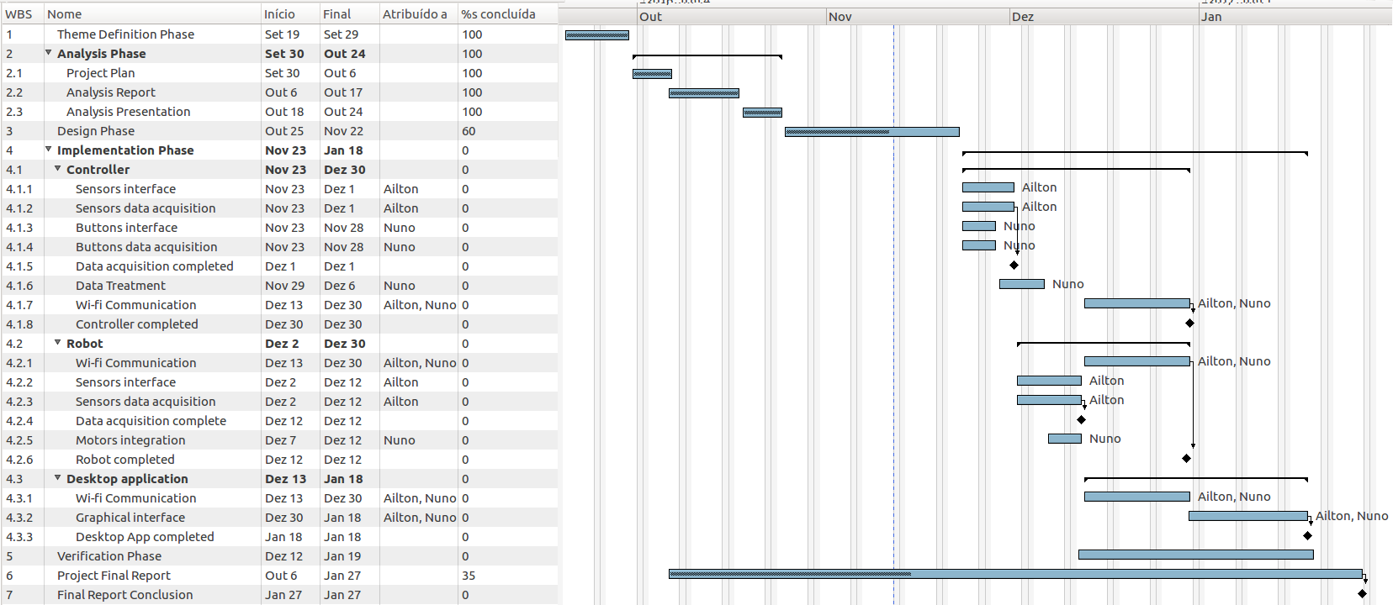
Gantt Diagram

Slide 136
References
SparkFun: Raspberry Pi 3 Datasheet https://cdn.sparkfun.com /datasheets /Dev/RaspberryPi/2020826.pdf
Adafruit Industries: Raspberry B+ Datasheet https://cdn-shop .adafruit. com/datasheets/pi-specs.pdf
STMicroelectronics: L298 Datasheet http://www.st.com/en/motor-drivers /l298 .html
SparkFun: Accelerometer Sensor Datasheet https://www.sparkfun.com/datasheets /Sensors/Accelerometer/ADXL345.pdf
Gearbest: Wireless WiFi Network Card: http://www.gearbest.com/raspberry-pi/ pp413677.html
Gearbest: Infrared Sensor Module: http://www.gearbest.com/sensors/pp_ 356161 .html
Gearbest: SR04 Ultrasonic Distance Sensor: http://www.gearbest.com/ development-boards/pp_58067.html
Gearbest: Robot Car Chassis Kit: http://www.gearbest.com/development-boards /pp_157852.html
Gearbest: Buzzer Alarm Module: http://www.gearbest.com/sensors /pp_346873 .html
Gearbest: Touch Button Module: http://www.gearbest.com/other-accessories /pp_402102.html?wid=21

Slide 137
References
Botnroll: Power Bank: http://www.botnroll.com/pt/pilhas/1278-banco-portatil-de-energia-power-bank-usb-5v-2600mah-cinza.html?search_query=power +bank &results=7
Botnroll: LEDs: http://www.botnroll.com/pt/leds/923-led-amarelo-3mm.html ?search_query=led&results=384
Google Cloud Plataform: Google APIs : https://cloud.google.com/speech/

Slide 138

Questions?

